Slide 1
Observations

Slide 2
Observations
“Observations” in MODFLOW allow model simulated values to be compared to observed values.
Types of Observations
Head
Flows at rivers, drains, streams, specified heads, and general head boundaries
Mass flux observations with MT3DMS

Slide 3
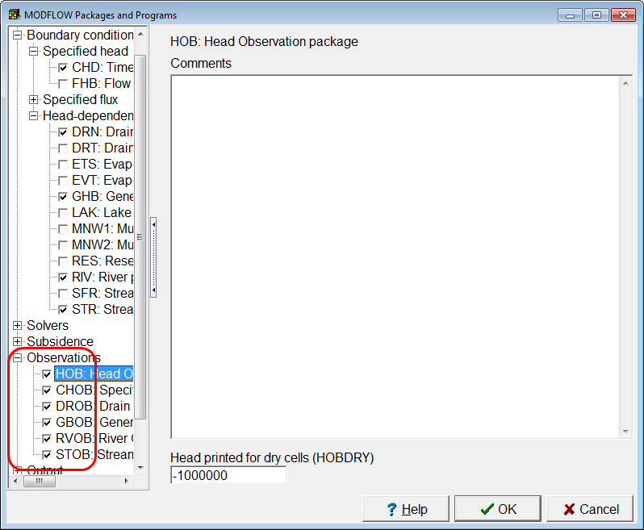
Observation Packages
Activate observation packages in the MODFLOW Packages and Programs dialog box.
Flow observations packages can only be selected if the corresponding boundary condition package is selected.

Slide 4
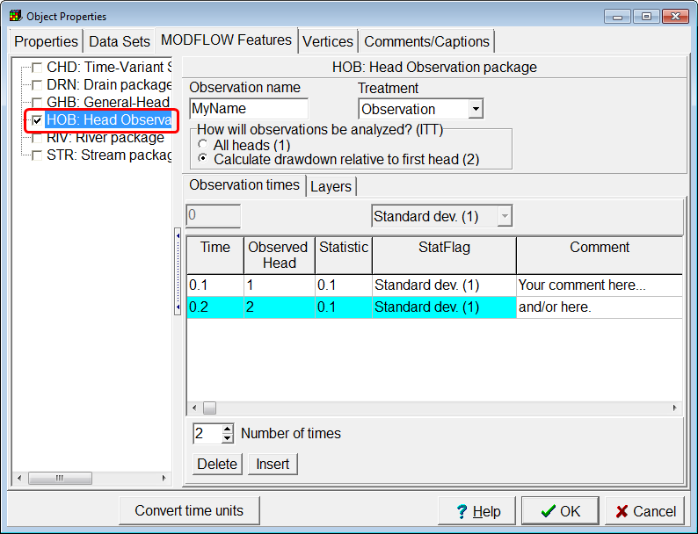
Head Observations
Define using a point object on the top view of the model.
Statistic and Stat flag are not used by MODFLOW but are used by UCODE.

Slide 5
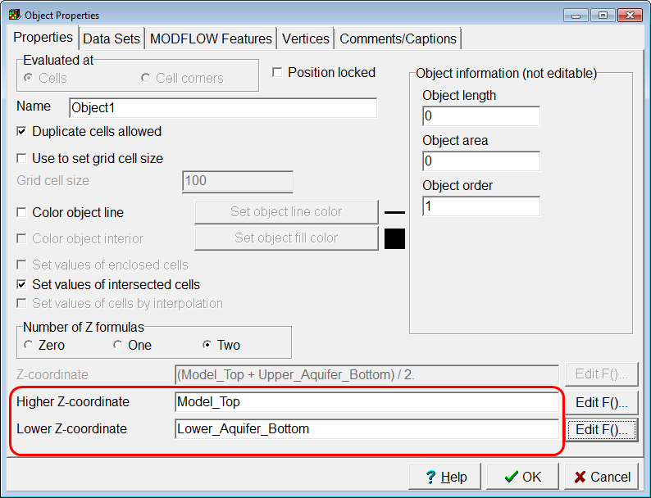
Multilayer Head Observations
Multilayer head observations are defined by specifying Z coordinates that stretch over several layers.

Slide 6
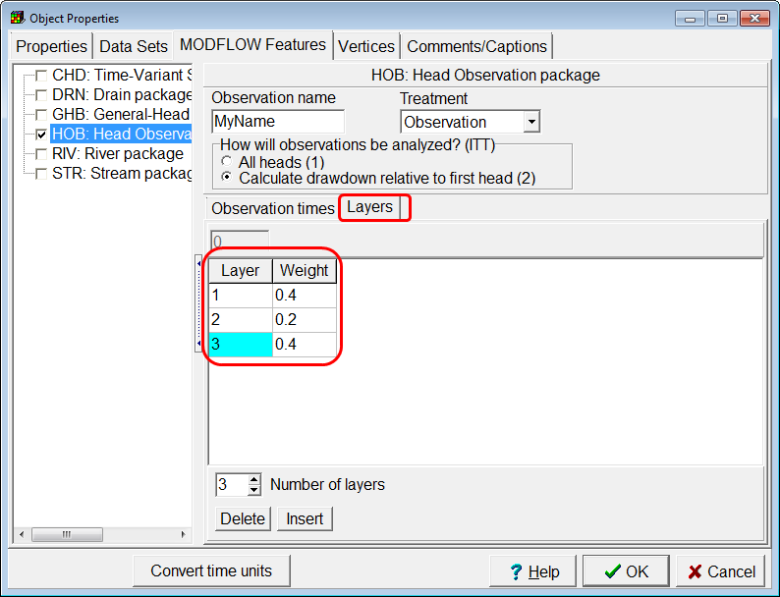
Layer Weights
Optional: The weights assigned to each layer can be specified.
If layer weights are not assigned, ModelMuse will use equal weights for all layers that are part of the observation.

Slide 7
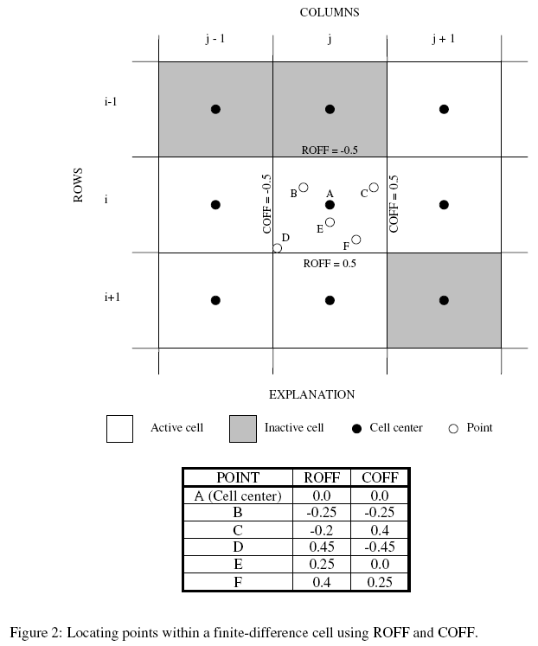
Row and Column Offsets
You don’t need to specify row and column offsets; ModelMuse can figure them out from the location of the point object.

Slide 8
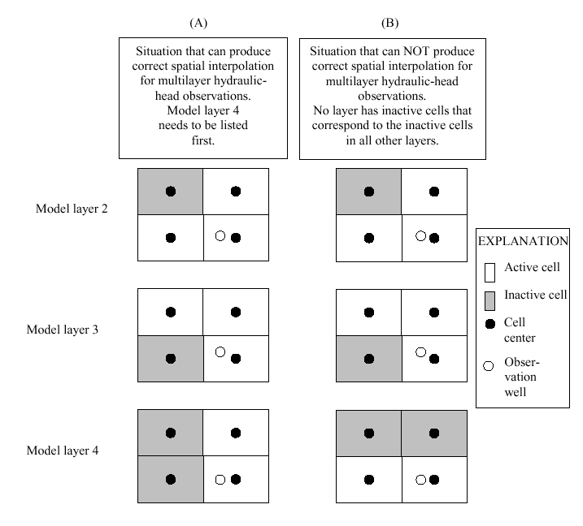
Layer order in multilayer head observations
ModelMuse figures out the correct order for layers in multilayer head observations

Slide 9
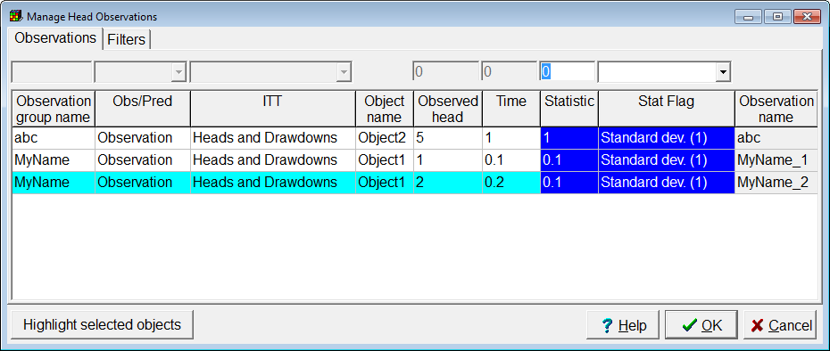
Manage Head Observations
The Manage Head Observations dialog box can be used to edit multiple observations simultaneously.

Slide 10
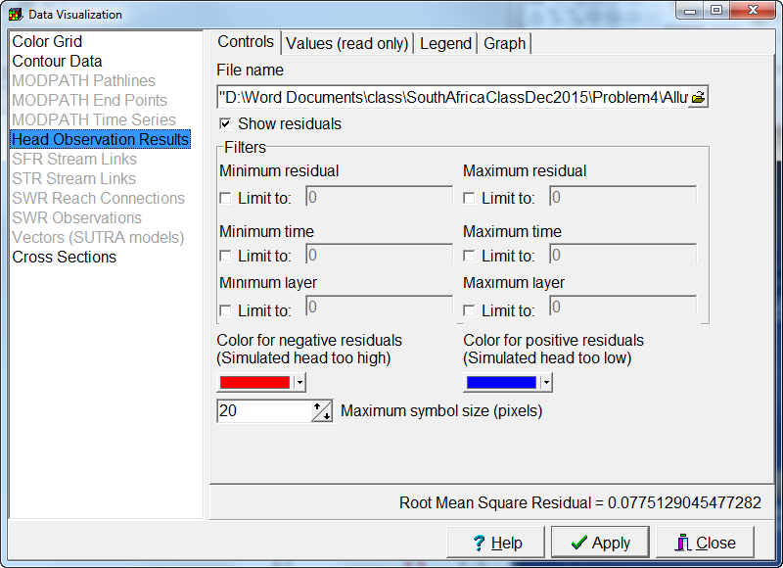
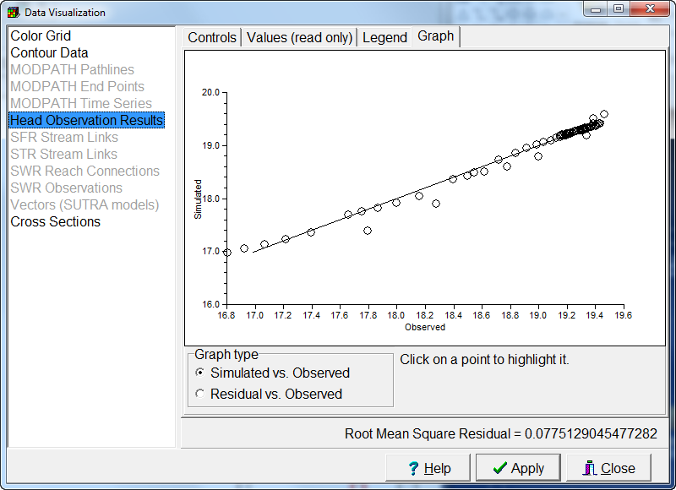
Import Head Observations and Plot Simulated vs. Observed

Slide 11
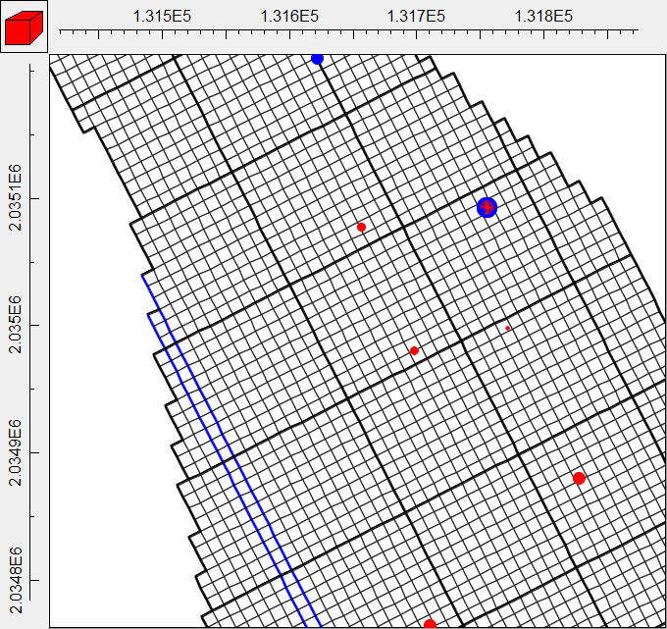
Plot Head Residuals Spatially

Slide 12
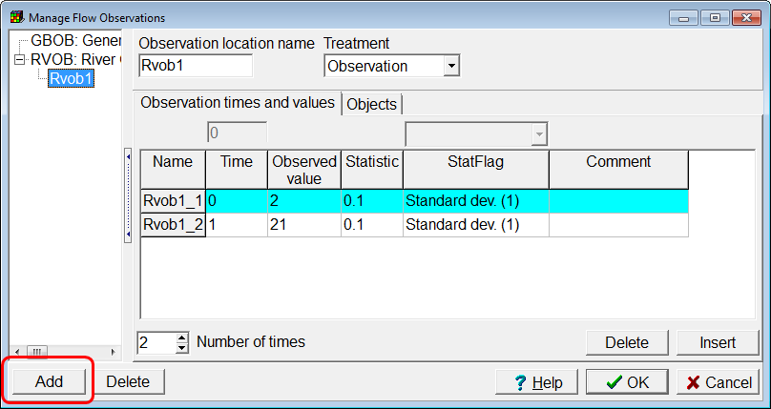
Flow Observations
Click the Add button to add a flow observation of the selected type.
Enter data for the observation.

Slide 13
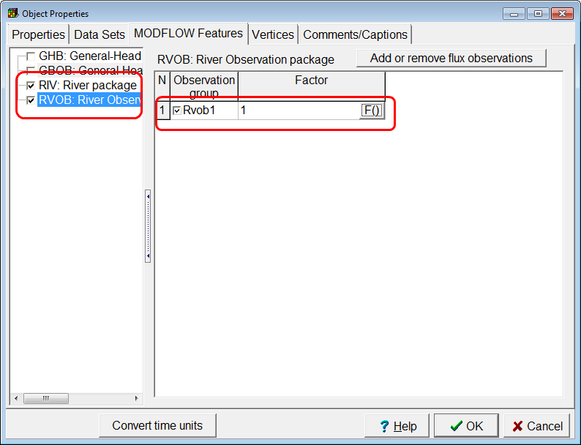
Define Flow Observation Cells
In an object that defines a flow boundary, check the check box for the flow observation
The “Factor” formula can be used to exclude some cells defined by the object as part of the observation.

Slide 14
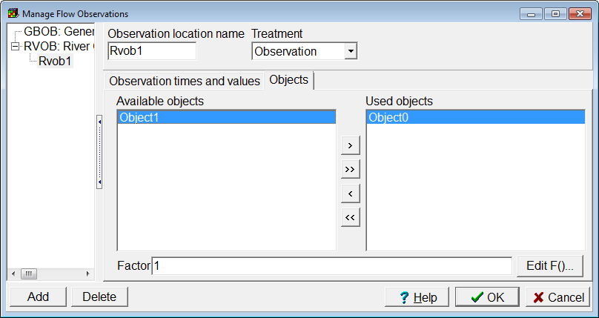
Define Flow Observation Cells (continued)
The Manage Flow Observations dialog box can also be used to choose which objects are part of a flow observation

